Slide 1
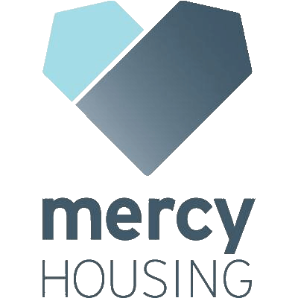
HUNTERS POINT SHIPYARD BLOCK 56
11 Innes Court
May 22, 2023

Slide 2
Agenda
Team Introductions
Project Overview
Logistics Plan
Air Monitoring
Schedule
Communications

Slide 3
Sarah Graham, Project Manager
Riley Jones, Associate Project Manager
Grace Serrano, Project Manager
Chris Brown, Senior Project Manager
Matt Norton, Superintendent
Norm Hayes, Director of Operations
Jasmine Kuo, Development Specialist

Slide 4
Development + Design Team
Development Team: SFHDC + Mercy Housing California
Architect: Van Meter Williams Pollack + Kerman Morris Associates
Contractor: Nibbi Brothers + Baines Group JV
Property Management: Mercy Housing Management Group
Resident Services: SFHDC
Sponsor: OCII

Slide 5
Project Overview
Total Units: 73 (reserved for incomes 40-50% AMI)
Large Family (per replacement requirements)
1 Family daycare
1 Manager’s unit
Amenities:
Courtyard
Community room
Parking:
Car parking – 0.65:1 ratio (48 spots)
Bike parking – 1:1 ratio (73 spots)
Notes:
Just family. No formerly homeless families.

Slide 6
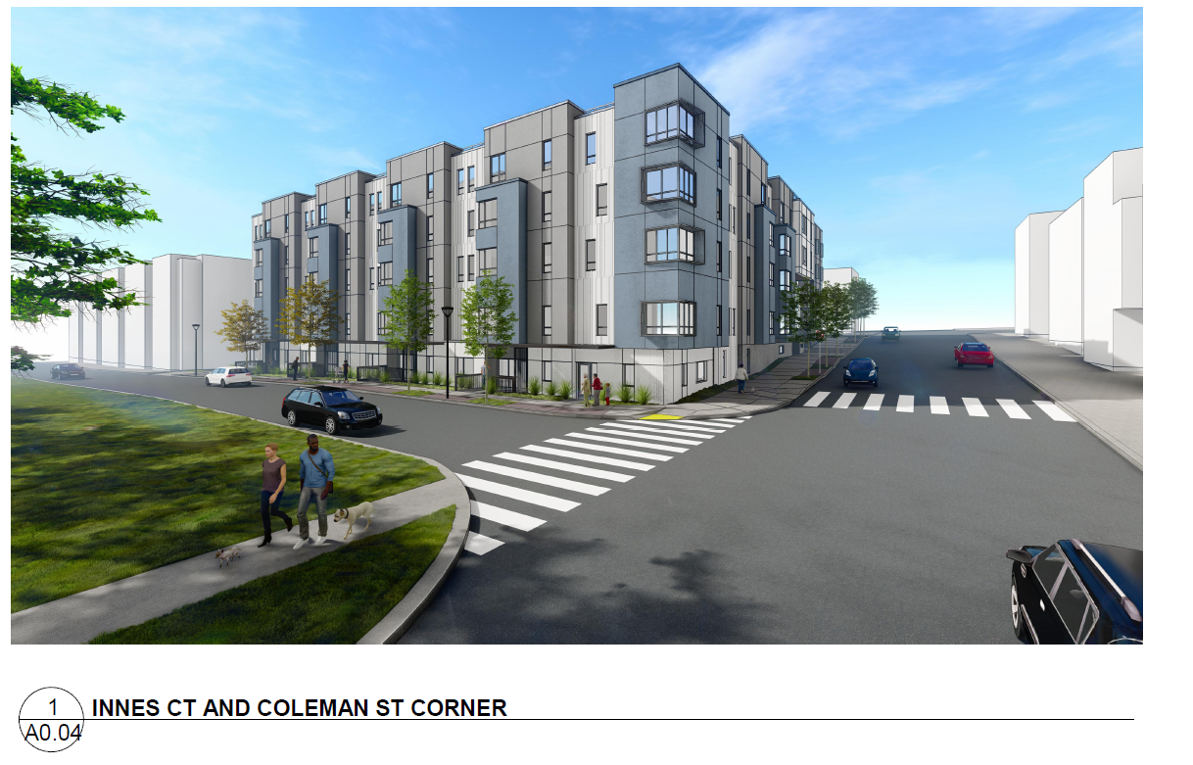

Slide 7
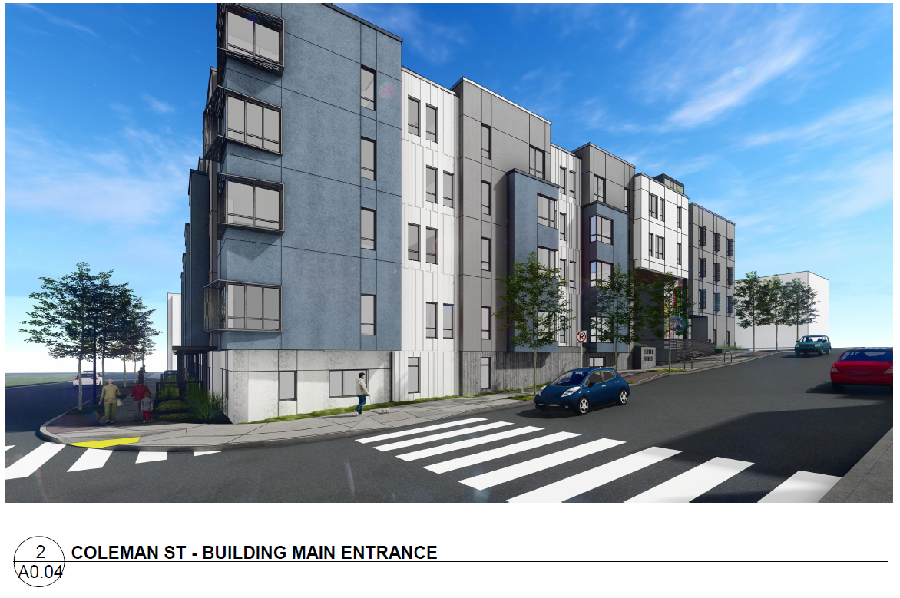

Slide 8
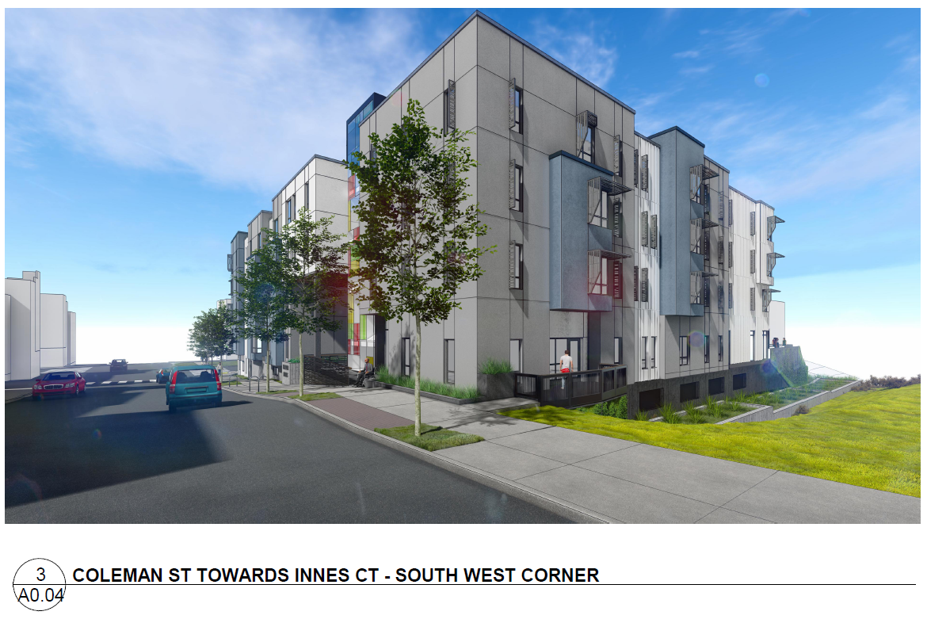

Slide 9
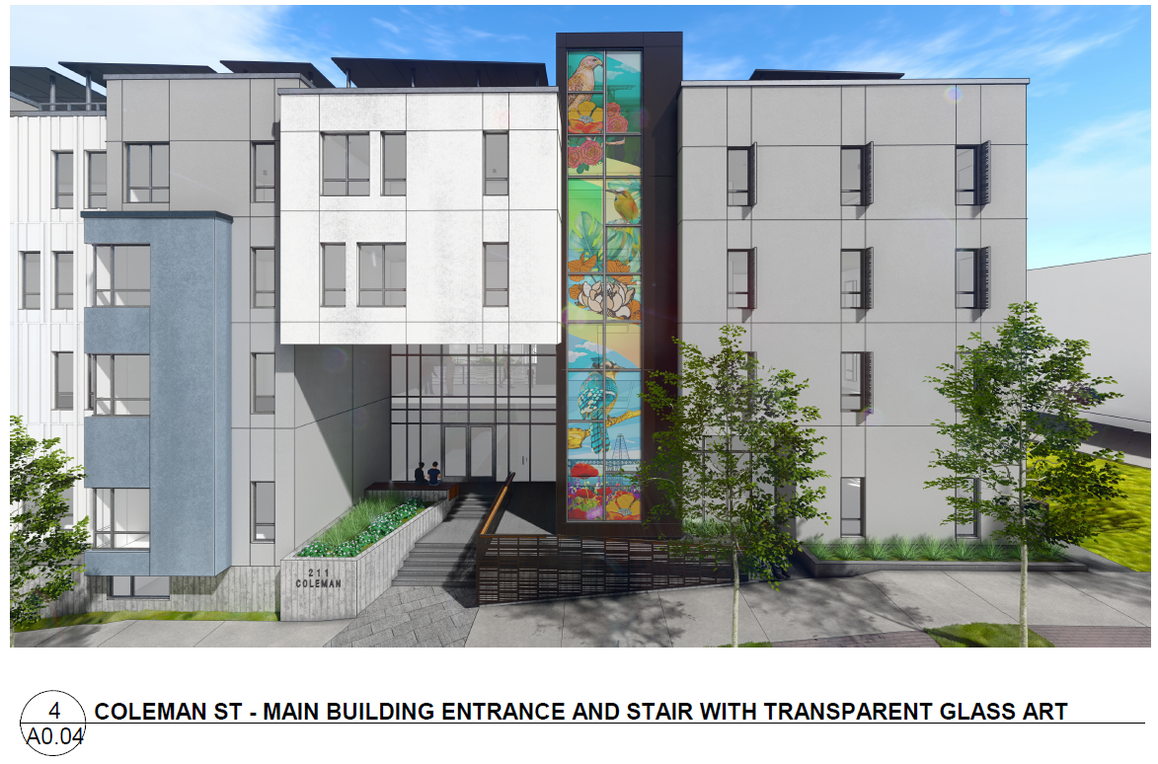

Slide 10
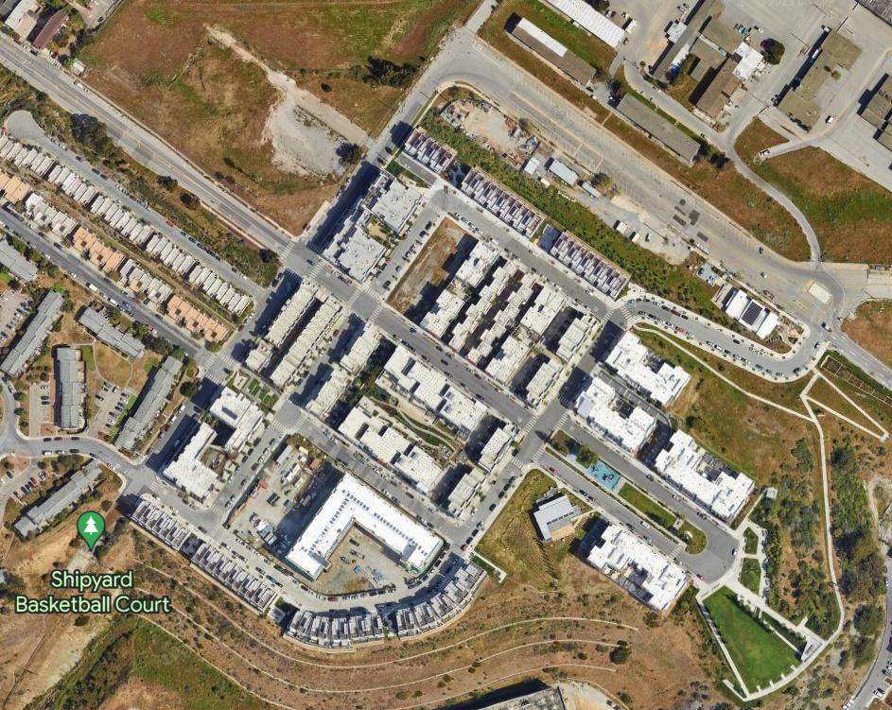
Additional contactor parking on Galvez St.

Slide 11
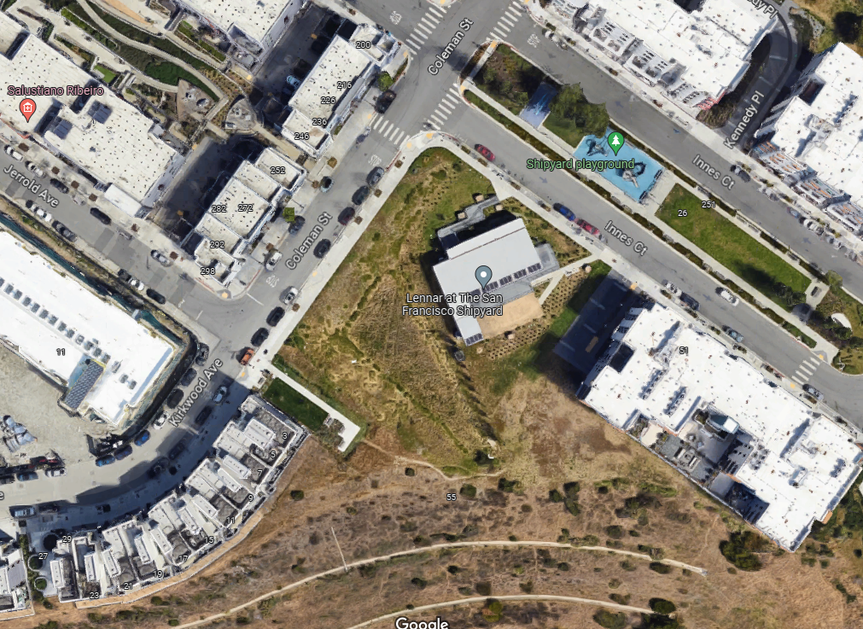

Slide 12
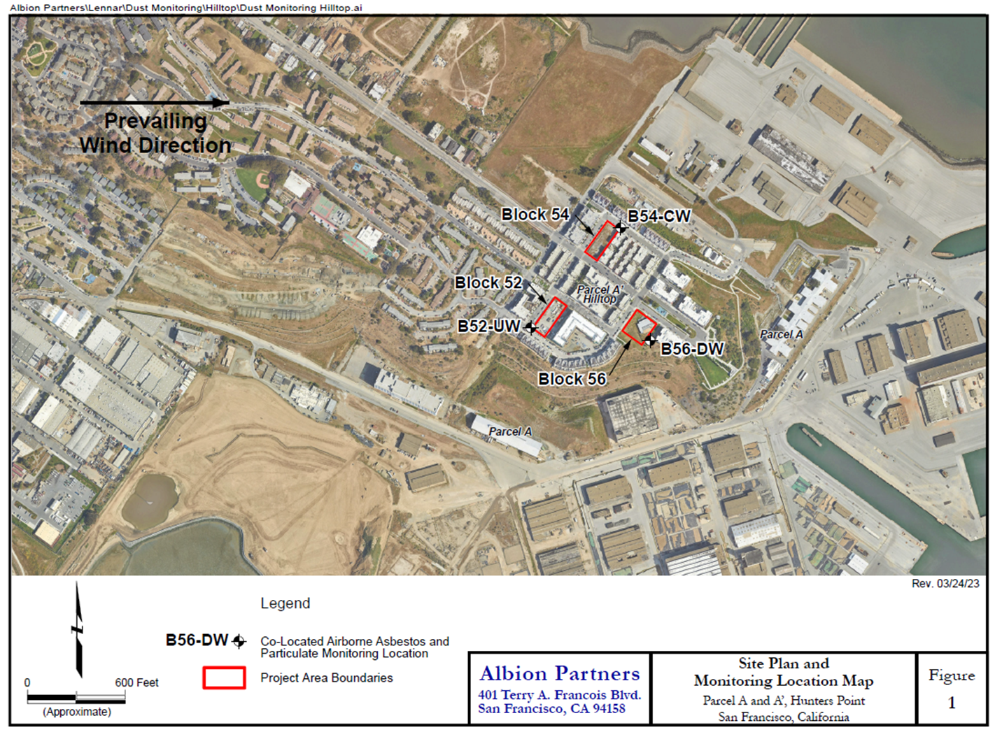

Slide 13
Schedule
Construction Project Start: May 2023
Daily Work Hours: 7 a.m - 5 p.m., M-F, occasional weekends
Foundation Complete: August 2023
Take Scaffolding Down: July 2024
Project Complete / Move-In: December 2024 / January 2025

Slide 14
Communications
11innescourt.org
Monthly construction update newsletters

Slide 15
Thank You!

Slide 16
Questions?

Slide 17
Appendix

Slide 18
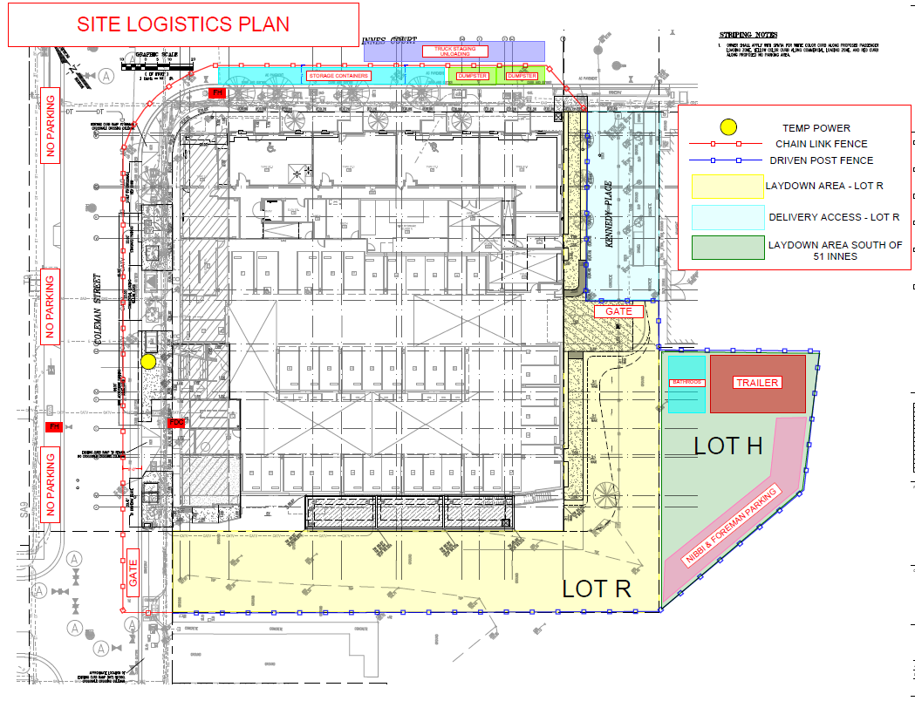
Notes:
Block 56 owner and building owner (aka Mercy/SFHCD) entered in to license agreement for Lot R and Lot H construction use. Have been vetted by HOA and OCII, respectively.
Contractor will not block Lot R – only used for pull-through

Slide 19
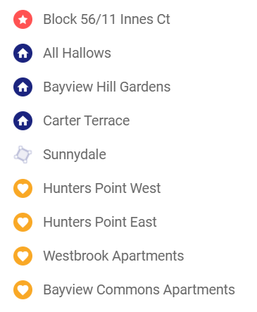
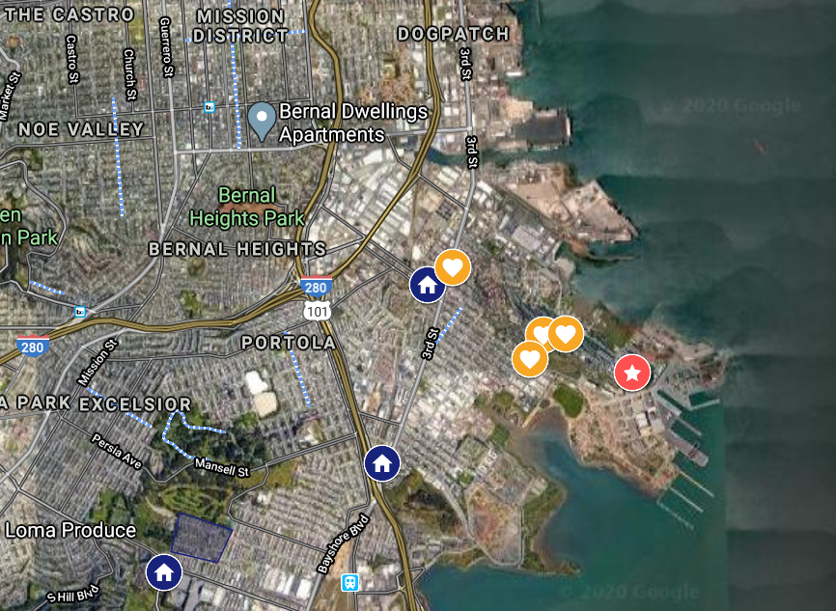
Neighborhood Experience

Slide 20
San Francisco Housing
Development Corporation
San Francisco Housing Development Corporation (SFHDC) builds racial and economic equity in low- and moderate-income communities of color in the Bayview-Hunters Point neighborhood and across San Francisco
SFHDC was founded over 30 years ago by African American community leaders from Western Addition and Bayview Hunters Point neighborhoods and is a registered 501 (c) (3) non-profit organization.
SFHDC envisions a San Francisco where healthy and safe housing is available to everyone regardless of race or income, where all residents see a vibrant future in their neighborhoods, and where all individuals are connected to opportunities to thrive economically, physically, and emotionally.
Notes:
Mercy Housing California and MHMG are affiliates of Mercy Housing, Inc., a national nonprofit housing development, management, and resident services organization founded by six congregations of Women Religious including the Daughters of Charity, the Sisters of Mercy, and the Sisters of St. Joseph of Orange. www.mercyhousing.org/california

Slide 21
Mercy Housing California
Mercy Housing California (Mercy) is a California-based nonprofit housing development organization with the mission of creating and strengthening healthy communities.
Mercy Housing California has created and preserved affordable housing for Californians for over 35 years.
Today Mercy owns and manages 151 communities with over 10,300 homes statewide for more than 19,600 people.
Mercy Housing Management Group (MHMG) will be the management agent for the property and is committed to providing quality property management services that reinforce the philosophy that all residents deserve respect, dignity, and a place to call home.
Notes:
Mercy Housing California and MHMG are affiliates of Mercy Housing, Inc., a national nonprofit housing development, management, and resident services organization founded by six congregations of Women Religious including the Daughters of Charity, the Sisters of Mercy, and the Sisters of St. Joseph of Orange. www.mercyhousing.org/california

Slide 22
What does Area Median Income (AMI) Mean?
All units at 11 Innes Court will be targeted to “Low Income” Residents at AMI lower than the City’s 100% AMI. Only people that make certain amounts of money can rent “affordable” housing.
Area median income is the average of money people make in a city or town of a certain household size. The government looks at how much money everyone makes and they come up with the average number that is around the middle of what everyone makes. That is called the “area median income” or “AMI” for short. Affordable rent for a household is about 30% of total income.
San Francisco Examples for Income Ranges
$0 a month
$7,500 a month
$15,000 +a month
AMI
Cathy
Eva
Hakeem
Notes:
Fiona - What is AMI?

Slide 23
Who can rent homes at 11 Innes Court?
Here is an example of households that might rent here to explain what “affordable” means:
Cathy works as an in-home health aid and lives with her wife, Denise, who is disabled and unable to work. Cathy’s caretaker salary is less than $3,000 a month. That is about 35% of the AMI. Cathy is what’s called very low income. Current rent is approximately $785/mo for their studio apartment.
Eva is a social worker who lives with her husband Meeko, a cook, and their two children. They make less than $5,300 a month. That is about 50% of the AMI. Eva is what’s called low income. Current rent is approximately $1,441/mo for a 2 bedroom.
Hakeem grew up in the Bayview and is a new SFUSD teacher who lives with his wife and three kids. Their household makes around $5,700 a month. That is about three-quarters of the AMI. Hakeem’s household is what’s called moderate income. Current rent is approximately $1,601/mo for a 3 bedroom.
Notes:
Focus on all of these individuals are part of households, i.e. this building with 30ish 2 BRs will have families were Ben Cathy Eva are part of households living with partners, kids. Fiona - Here are examples of people who might live in our future development and how much they would pay. This ranges from Ben, who has SSI income Hakeem, a teacher.
In San Francisco one challenge we have is that there is a shortage of housing for our neighbors at all of these income levels. We believe it is important to try to serve those at the lowest income levels, and can also serve those at slightly higher income levels (Hakeem) who may have just as a challenging time to find a place to live in San Francisco.

Slide 24
Who can rent homes at 11 Innes Court?
Target Rents & Incomes | MOHCD Average Median Income | 35% | 50%
Studios | Income Max (2 person household) | $35,900 | $51,250
 | Estimated Monthly Rent (2020 est.) | $785 | $1,121
2 Bedrooms | Income Max (4 person household) | $44,850 | $64,050
 | Estimated Monthly Rent (2020 est.) | $1,009 | $1,441
3 Bedrooms | Income Max (6 person household) | $52,000 | $74,300
 | Estimated Monthly Rent (2020 est.) | $1,121 | $1,601

Slide 25
Unit Mix
 | # of Apts | MOHCD 35% AMI | MOHCD 50% AMI
Studio | 4 | 0 | 4
1 Bdrm | 18 | 3 | 15
2 Bdrm | 31 | 8 | 23
3 Bdrm | 16 | 3 | 13
4 Bdrm | 2 | 0 | 2
5 Bdrm | 1 | 0 | 1
Manager’s Unit | 1
TOTAL | 73 | 14 | 58
% of units |  | 20% | 80%

Slide 26
Staffing & Operating
MHMG Property Management
1 Property Manager
1 Assistant Project Manager/Desk Clerk Hybrid
Maintenance and Janitorial
SFHDC Resident Services
1.0 FTE Service Coordinator
Additional on-site programming per SFHDC fundraising/in kind

